Slide 1
Cache Coherence Enforcement Protocol Simulation and Evaluation
Team #4
Siddhant Kulkarni
Ritesh Sangurmath
Ranjan Yadav

Slide 2
Content
Throwback Tuesday
The Simulator
Parameter Specification
Sequence Generator
Output
Pending Implementation
Simulator Internals
Evaluation
Experimental Results
Key Observations
Conclusion
References

Slide 3


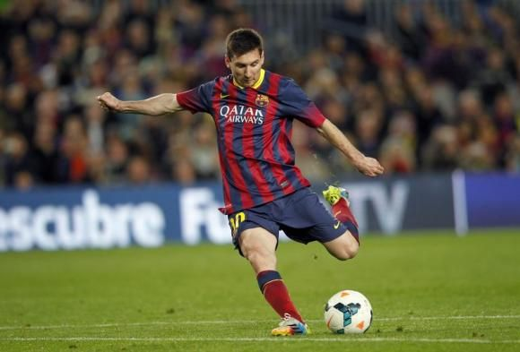
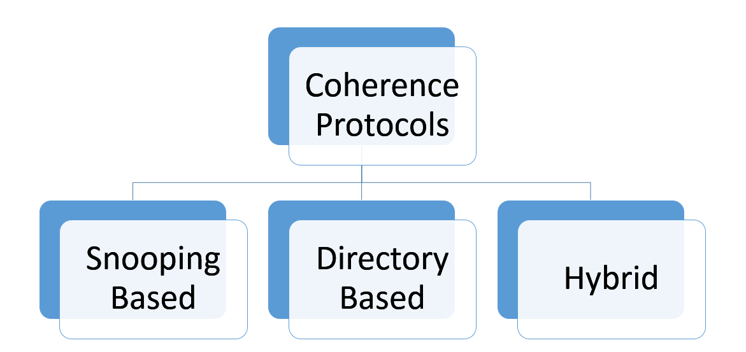
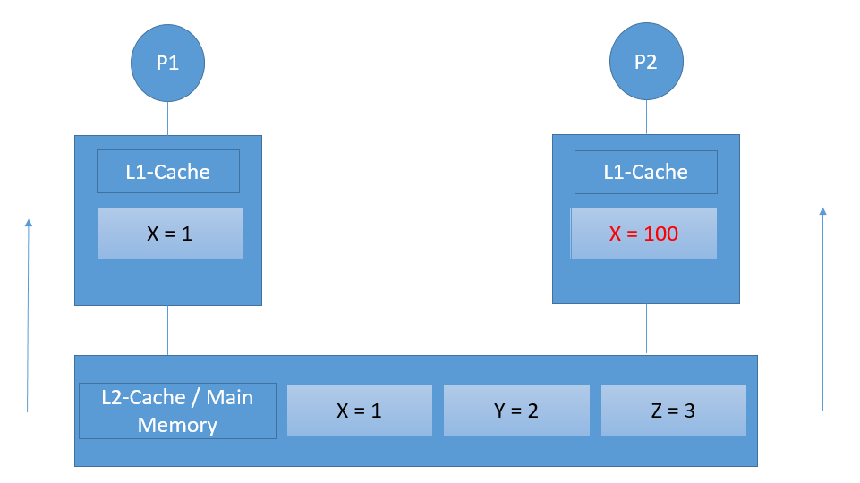


Throwback Tuesday
Multi-processor Architectures
Cache Coherence Problem
Three Types of Protocols
Our focus on Snooping(bus) protocols
MSI
MOSI
MESI
MERSI
DRAGON
FIREFLY

Slide 4
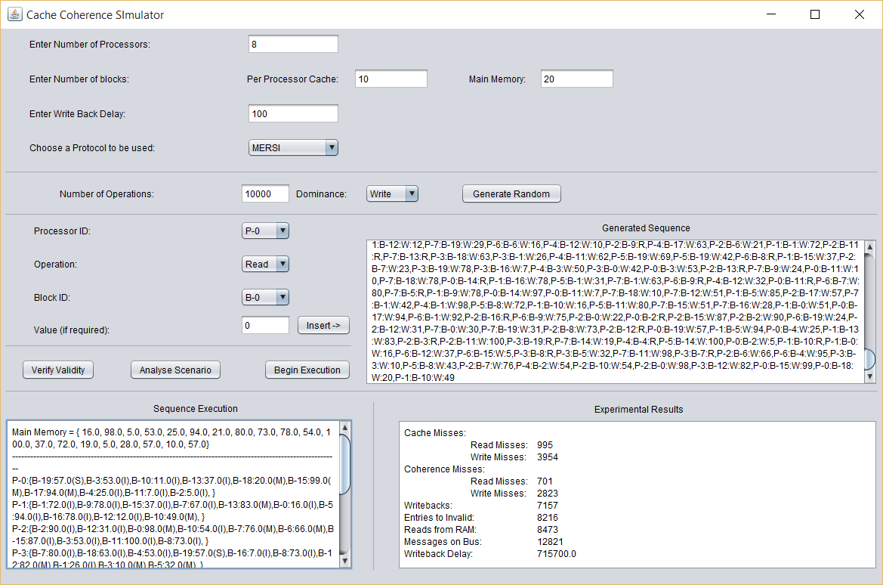
The simulator

Slide 5
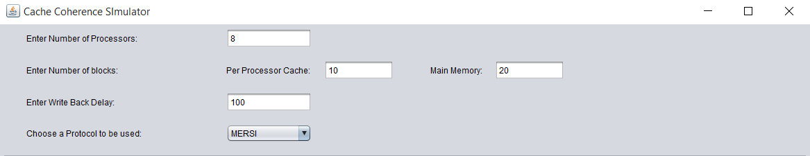
Let us look at it one at a time!
Parameter Specification
Minimum = 2
Minimum = 1
Any one of 6 protocols

Slide 6
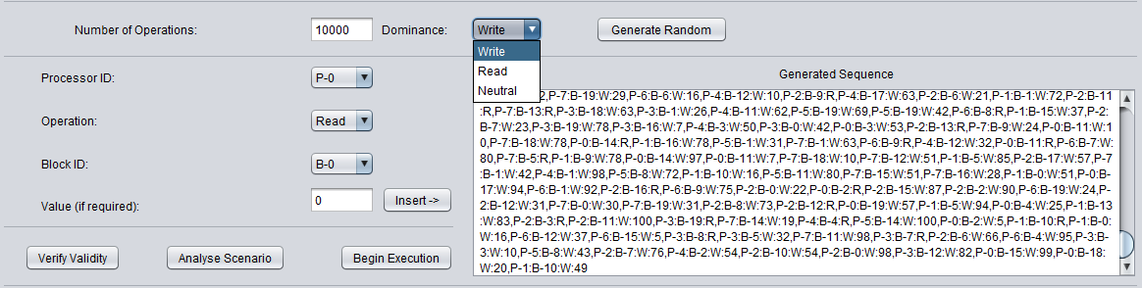
The Sequence Generator
Choose Dominant Operation
Random Sequence Generator
Generated Sequence
Manual Sequence Generator

Slide 7
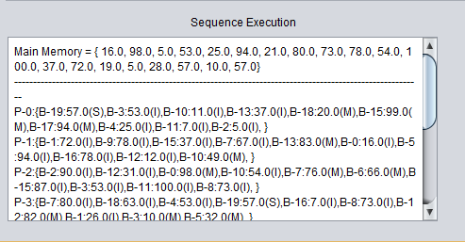
The Output
Main Memory Status
Proc- 0
Block 19
Value=57
State=Shared
Proc 1
Block 0
Value=16
State=Invalid

Slide 8
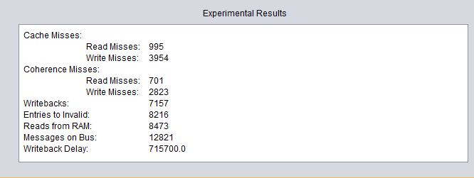
The Output Returns
Block absent from local cache
Block present in local cache,
But is in Invalid State
**********IMP**********

Slide 9
Pending Implementation
Sequence Analyser
Number of Operations
Number of Reads
Number of Writes
Average Number of Reads on one block
Average Number of Writes on one block
Average Number of Operations between two reads on the same block
Average Number of Operations between two writes on the same block

Slide 10

Simulator Internals

Slide 11
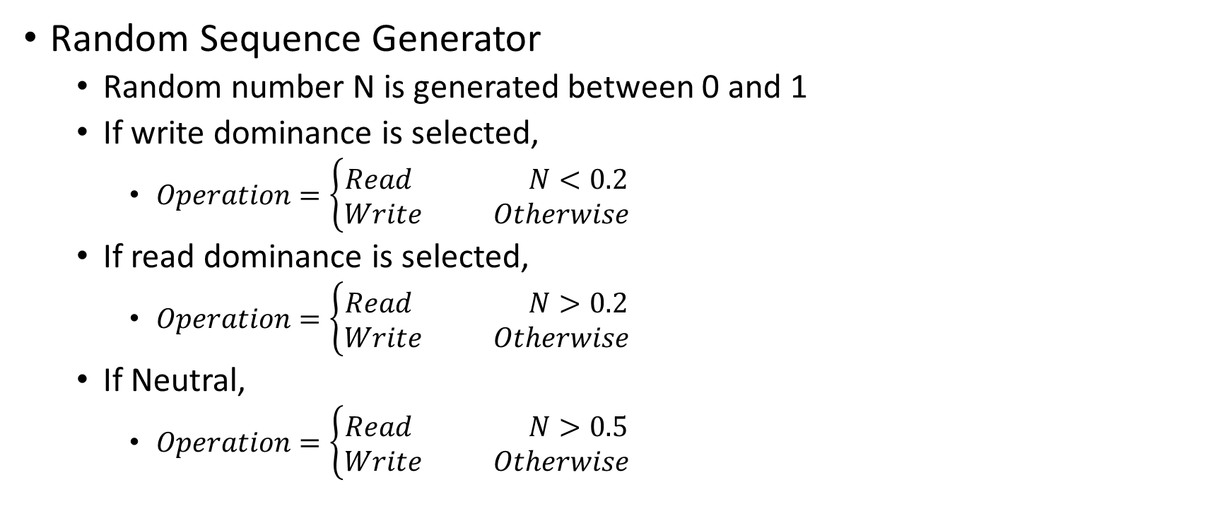
Simulator Internals
Random Sequence Generator
Random number N is generated between 0 and 1
If write dominance is selected,
$Operation=\left\{\begin{aligned}Read N<0.2 \\ Write Otherwise\end{aligned}\right.$
If read dominance is selected,
$Operation=\left\{\begin{aligned}Read N>0.2 \\ Write Otherwise\end{aligned}\right.$
If Neutral,
$Operation=\left\{\begin{aligned}Read N>0.5 \\ Write Otherwise\end{aligned}\right.$

Slide 12
Simulator Internals
Sequence Execution Steps
For each operation in scenario
If read,
Execute Remote Read for all other processors
Writebacks or Block sharing occur if required by chosen protocol
Execute Local Read for current processor
If write
Execute Remote Write for all other processors
Same as Remote Read -> Writebacks/Block sharing -> Invalidations
Execute Local Write

Slide 13

Evaluation

Slide 14
Evaluation
Parameters that we needed to consider:
Number of Processors
Number of Blocks in Local Cache
Number of Blocks in Main Memory
Protocols
Scenarios
Varying Length
Type
Write Dominant
Read Dominant

Slide 15
Evaluation, cntd.
Here is how we defined scenarios which will allow us to do two things
Exercise the simulator thoroughly
Allow us to understand how the different protocols perform with different configuration
Number of Operations in Sequence
100
500
1000
5000
10000
Protocol under Evaluation
MSI
MOSI
MESI
MERSI
FIREFLY
DRAGON
Number of Processors
4
8
Number of Blocks in Local Cache
5
10
Dominant Operation
Read
Write
X
X
X
X

Slide 16
Evaluation, cntd.
We evaluated the protocols based on following parameters:
Cache Misses:
Read Misses
Write Misses
Coherence Misses:
Read Misses
Write Misses
Delay added due to writebacks
Number of messages sent over the bus
Number of entries to invalid state
Number of Reads from RAM

Slide 17
Evaluation - The Experiment Rises
40 Sequences X
6 Protocols =
240 Experiments
X
7 Parameters
=
1680 Results

Slide 18
Scenario Description
Scenario 1-5
4 processors
Local cache holds 5 blocks
Main Memory holds 20 blocks
Write Dominant
Scenario 6-10
Same as 1-5
Read Dominant
Scenario 11-20
Same as 1-10
8 Processors
Scenario 31-40
Same as 11-20
Local cache holds 10 blocks
Scenario 21-30
Same as 1-10
Local Cache holds 10 blocks

Slide 19
Scenario Description, contd.
Scenario | Number of Operations
1,6,11,16,21,26,31,36 (N%5=1) | 100
2,7,12,17,22,27,32,37 (N%5=2) | 500
3,8,13,18,23,28,33,38 (N%5=3) | 1000
4,9,14,19,24,29,34,39 (N%5=4) | 5000
5,10,15,20,25,30,35,40 (N%5=0) | 10000

Slide 20
Experimental Results
MSI, MOSI, MESI, MERSI
DRAGON, FIREFLY
Write Dominant
Read Dominant
Write Dominant
Read Dominant
Notes:
Consistent

Slide 21
Experimental Results
Larger local cache = Less cache misses

Slide 22
Experimental Results
Only MSI, MOSI, MESI, MERSI
Write Dominance=More coherence misses

Slide 23
Experimental Results

Slide 24
Experimental Results
Results for Number of entries to Invalid State are consistent with what we see in Coherence Misses
Remain the same across MSI, MOSI, MESI and MERSI
Zero for DRAGON & FIREFLY since they do not have an Invalid state

Slide 25
Experimental Results
Rest of the scenarios follow the observed pattern. We will include those results in the report in order to save time.

Slide 26
Experimental Results

Slide 27
Experimental Results

Slide 28
Key observations
Coherence protocols do not have an impact on Cache misses
MSI, MOSI, MESI, MERSI variations are not intended to reduce number of coherence misses, instead they vary
# reads from RAM
MOSI requires relatively less
# messages that are sent on the Bus
# required writebacks
DRAGON and FIREFLY
have no invalid state
reduce the number of writebacks required
Increase the number of messages sent over the bus

Slide 29
Conclusion
We have implemented:
Multiprocessor architecture for cache simulation
Random Sequence Generator and Sequence Validator
6 Cache Coherence protocols
Evaluation Engine that evaluates the performance of these protocols based on aforementioned parameters
Write-Invalidate protocols (MSI, MOSI, MESI, MERSI)
Require less bandwidth than Write Update protocols
Attempt to reduce number of messages on Bus and reads from RAM/lower level cache
Write-Update protocols (DRAGON, FIREFLY)
Immediately update values in all local caches -> More bandwidth required
Reduce the number of reads required from RAM/lower level cache

Slide 30
References
[01]"What Is Cache Coherence? Webopedia Definition". Webopedia.com. N.p., 2016. Web. 29 Mar. 2016.
[02]"Cache Coherence". Wikipedia. N.p., 2016. Web. 29 Mar. 2016.
[03]James Archibald and Jean-Loup Baer. 1986. Cache coherence protocols: evaluation using a multiprocessor simulation model. ACM Trans. Comput. Syst. 4, 4 (September 1986), 273-298.
[04]"What Is Snooping Protocol? - A Definition from The Webopedia IT Dictionary". Webopedia.com. N.p., 2016. Web. 29 Mar. 2016.
[05]"Cache Coherence Problem - Georgia Tech - HPCA: Part 5". YouTube. N.p., 2016. Web. 29 Mar. 2016.

Slide 31
References
[06]"Cache Coherence". Slideshare.net. N.p., 2013. Web. 29 Mar. 2016.
[07]Lawrence, Ramon. "A survey of cache coherence mechanisms in shared memory multiprocessors." Proceedings of the International Conference on Advances in Computer Science and Electronics Engineering. 1998
[08]A. Agarwal, R. Simoni, J. Hennessy and M. Horowitz, "An evaluation of directory schemes for cache coherence," Computer Architecture, 1988. Conference Proceedings. 15th Annual International Symposium on, Honolulu, HI, 1988, pp. 280-289.
[09]Daniel J. S. Mark D. H. David A. W., “A Primer on Memory Consistency and Cache Coherence,” Morgan Claypool Publishers, 2011.
[10]"MESI, MOSI, MOESI Solution Quiz - Georgia Tech - HPCA: Part 5". YouTube. N.p., 2016. Web. 29 Mar. 2016.
[11]"19 5 L18S5 Cache Coherence Protocols". YouTube. N.p., 2016. Web. 29 Mar. 2016.

Slide 32
References
[12] S, M., & K, D. (2013). Hybrid Cache Coherence Protocol for Multi-Core Processor Architecture. International Journal of Computer Applications, 70(14), 24-29. doi:10.5120/12031-8060
[13] S. Al-Hothali, S. Soomro, K. Tanvir, R. Tuli, “Snoopy and Directory Based Cache Coherence Protocols: A Critical Analysis,” Information & Communication Technology, vol.4, no.1, pp.1,10, 2010.
[14] J. Li et al., "A New Kind of Hybrid Cache Coherence Protocol for Multiprocessor with D-Cache," Future Computer Science and Education (ICFCSE), 2011 International Conference on, Xi'an, 2011, pp. 641-645.
[15] J. Li, L. Shi, Q. Li, C. J. Xue and Y. Xu, "Thread Progress Aware Coherence Adaption for Hybrid Cache Coherence Protocols," in IEEE Transactions on Parallel and Distributed Systems, vol. 25, no. 10, pp. 2697-2707, Oct. 2014.

Slide 33
Any questions?

Slide 34
Thank you!

